Slide 1


COMMON APP READY
The Recommendation Process
© 2016 The Common Application • commonapp.org

Slide 2
RECOMMENDATION PROCESS AGENDA
FERPA Release Authorization
Invite & Assign Recommenders
Status & Management
^{© 2016 The Common Application}

Slide 3
FERPA RELEASE AUTHORIZATION
The FERPA Release Authorization is the first step you need to take to start inviting and assigning your recommenders.
^{© 2016 The Common Application}
Notes:
Don’t forget: You’ll need to enter your current or most recent school in the Education screen of the Common App before you can access and complete the Recommenders and FERPA area.

Slide 4
WHAT IS FERPA?
FERPA stands for The Family Educational Rights and Privacy Act, a federal law that protects the privacy of student education records.
First step toward completing the recommendation process for your applications.
The FERPA release needs to be completed only once and will be applied to all schools on your My Colleges list.
^{© 2016 The Common Application}
Notes:
How does FERPA relate to your college application? Two ways.
You need to give consent for the schools you have attended to release your education records (grades, transcripts, test scores) to the colleges and universities to which you are applying.
After you enroll at a college, FERPA gives you the right to access your education records, including confidential letters of recommendation submitted to that college on your behalf (if you enroll at an institution that maintains such records post-enrollment).

Slide 5
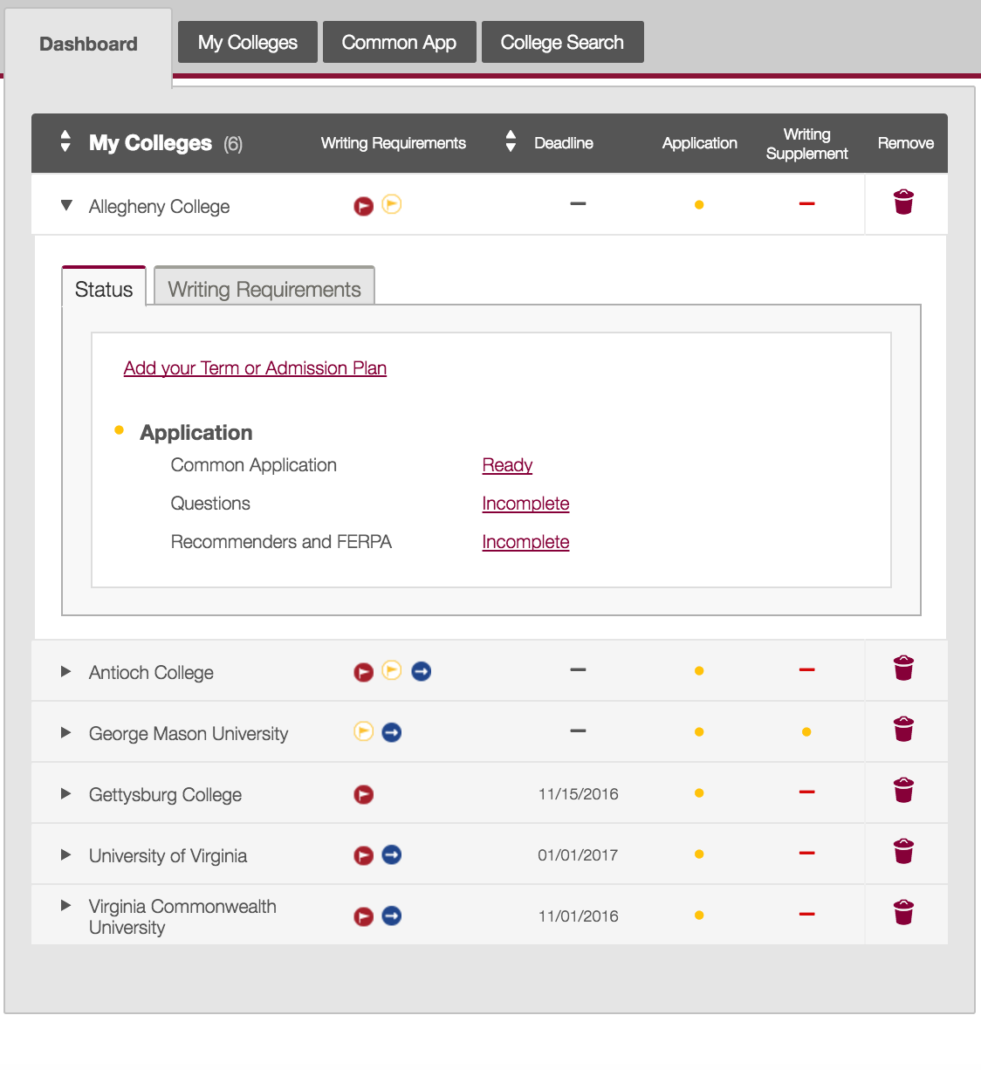
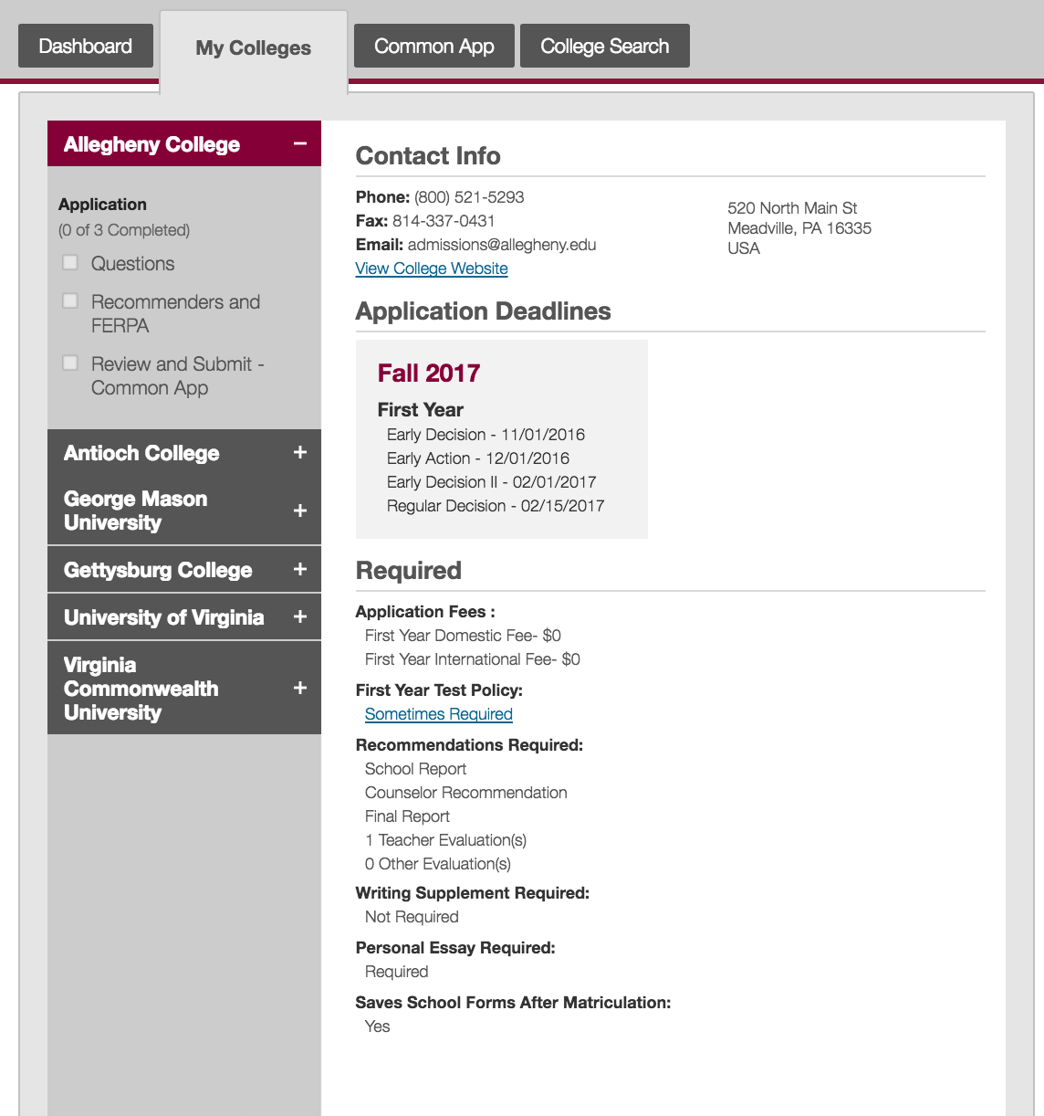
or
^{© 2016 The Common Application}
Notes:
Access the FERPA Release Authorization two ways.
Click on the name of a school from your Dashboard and then click the ‘Incomplete’ link next to Recommenders and FERPA.
Select a school from your My Colleges tab and click the Recommenders and FERPA section.

Slide 6
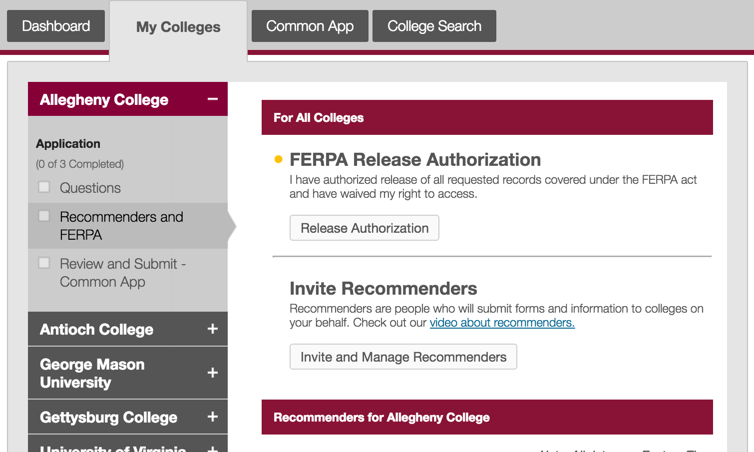
^{© 2016 The Common Application}
Notes:
Then click the “Release Authorization” button.

Slide 7
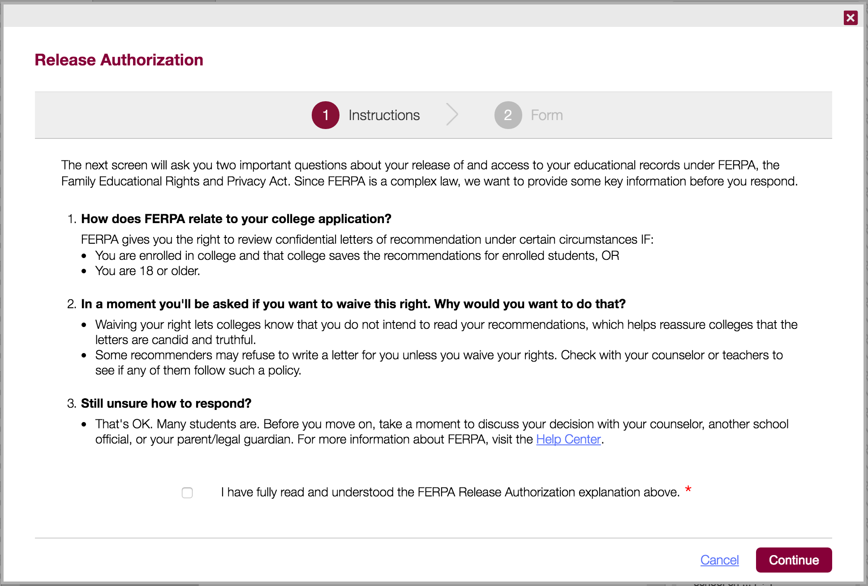

^{© 2016 The Common Application}
Notes:
The first step will provide you with some information about FERPA and how it relates to your college applications.
Be sure to read and understand these instructions completely before you proceed. Once you’ve done so, check the affirmation box and continue to the next step.

Slide 8
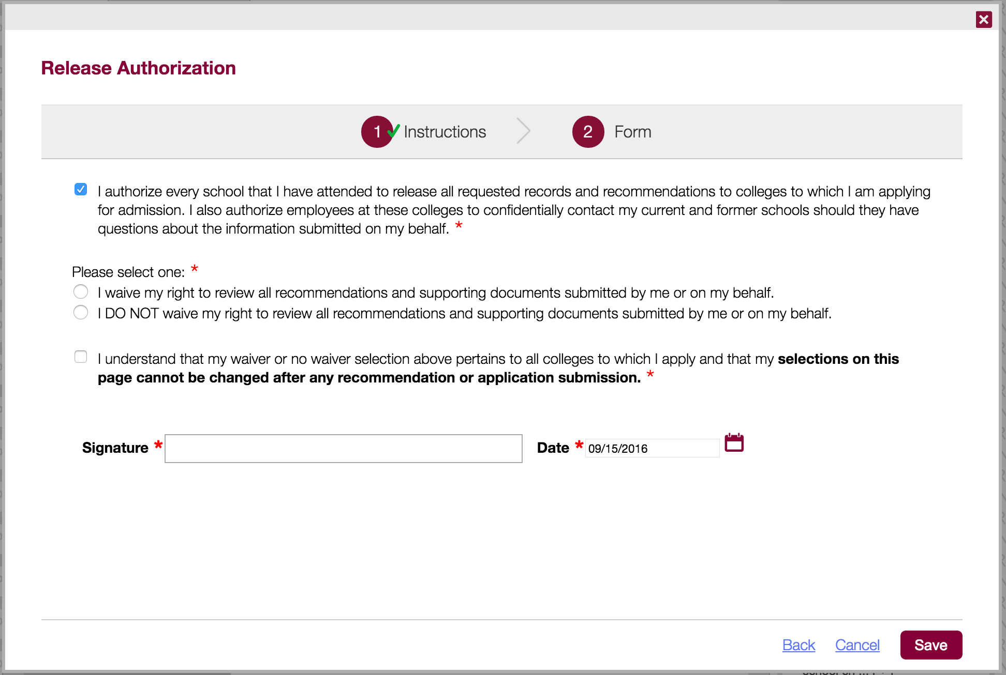
^{© 2016 The Common Application}
Notes:
You’ll be asked to:
Authorize the release of any pertinent school records to the colleges and universities that you plan on applying to through the Common App.
Whether you want to waive or not waive your right to review the recommendations and supporting documents submitted to a college on your behalf after you enroll in that college.
Check the affirmation box at the bottom and provide your electronic signature.
After you complete the release authorization you can proceed to invite your counselor, teachers, and other recommenders.

Slide 9
SHOULD I WAIVE MY RIGHTS?
Waiving your rights lets colleges know that you do not intend to read your recommendations, which helps reassure colleges that the letters are candid and truthful.
Some recommenders may not want to write a letter for you unless you waive your rights. Check with your counselor or teachers to see if any of them follow such a policy.
Before you respond to the FERPA waiver question, take a moment to discuss your decision with your counselor, school official, or your parent or legal guardian.
^{© 2016 The Common Application}
Notes:
Your selection to waive or not waive your right to review all recommendations and supporting documents cannot be changed once you submit your first application within the Common App, or once a recommender submits a form on your behalf.

Slide 10
INVITE & ASSIGN RECOMMENDERS
Recommenders are the people who will submit forms and information to colleges on your behalf.
^{© 2016 The Common Application}
Notes:
In the Common App you can assign your counselor, teachers, and other recommenders to submit recommendations to the colleges and universities to which you are applying.
The required recommendations are determined by each specific college, so be sure to double check each college’s recommendation requirements.

Slide 11
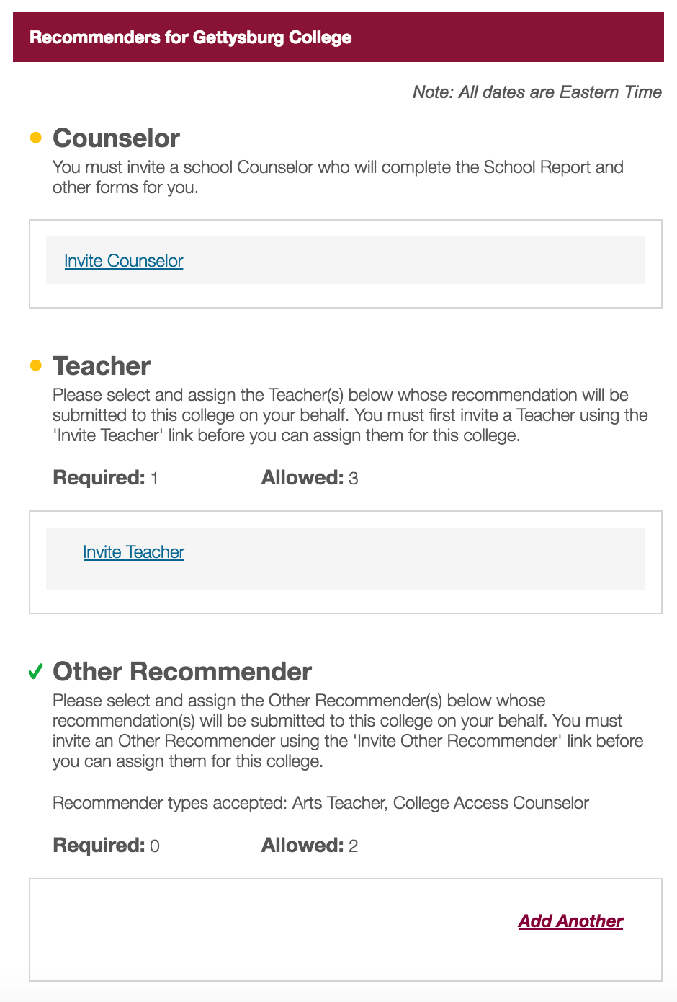
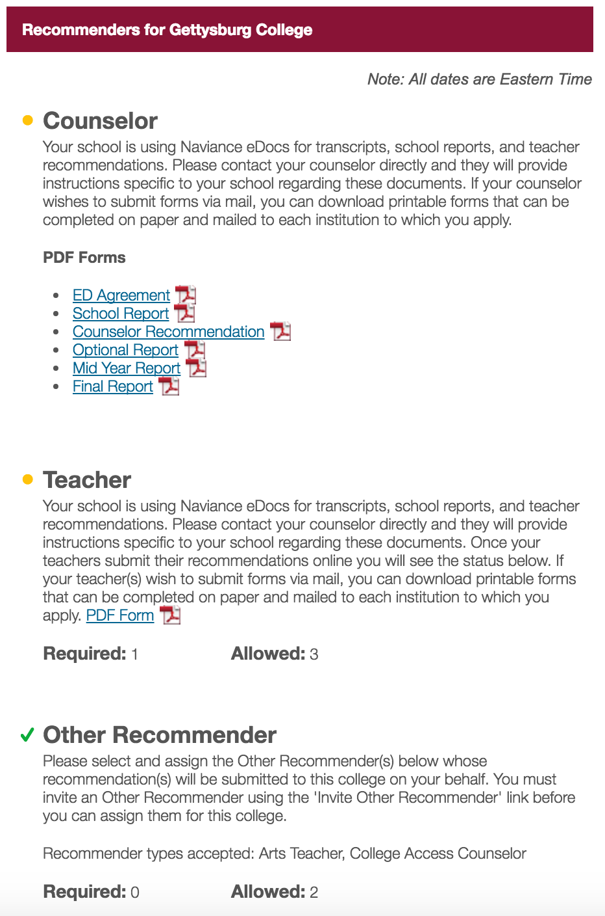
There are two commonly used systems to submit recommendations and school forms:
^{Common App}
^{Naviance eDocs}
Notes:
There are two commonly used systems to submit recommendations and school forms: The Common App and Naviance.
If your high school uses the Common App to submit recommender forms you will invite your recommenders in the Recommenders and FERPA section, which we will review.
If your high school submits recommender forms through Naviance, you invite your counselor and teachers through Naviance. (You will still invite your Other Recommenders through the Common App though.)

Slide 12
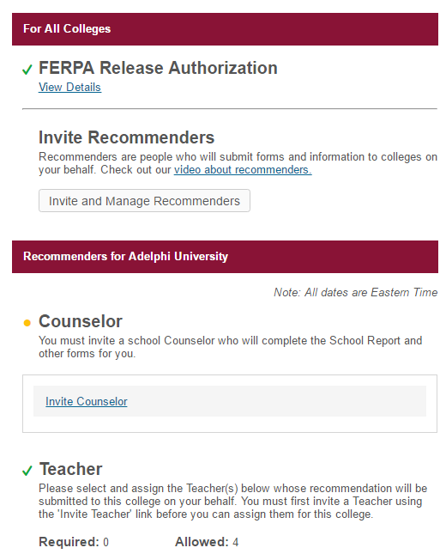

Once you’ve completed your FERPA release authorization, you can start inviting and assigning recommenders using the “Invite and Manage Recommenders” link.
Pro tip: It’s a good idea to speak to your teachers in person before sending them an invitation.
^{© 2016 The Common Application}

Slide 13
RECOMMENDER TYPES
1. Counselor
2. Teacher
Math, English, Science, Foreign Language, Social Studies, Other
3. Other Recommender
Arts Teacher, Clergy, Coach, College Access Counselor, Employer, Family Member, Peer, Other
There are three types of recommenders you can invite:
^{© 2016 The Common Application}

Slide 14
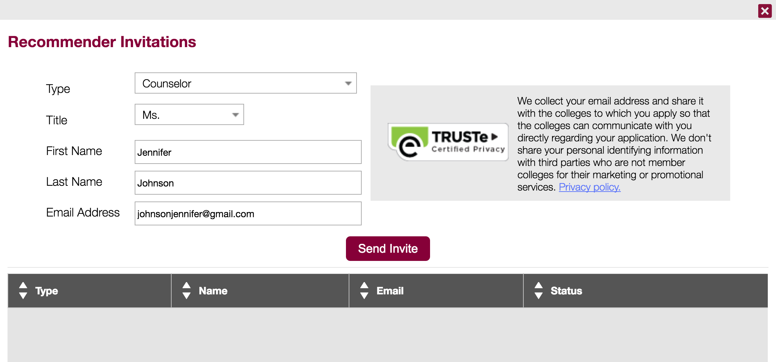

Select the Recommender Type and fill out some basic information like first name, last name, and email address.
^{© 2016 The Common Application}
Notes:
You’ll be asked to select the Recommender type: Counselor, Teacher, Other Recommender, Parent.
If you do not enter an email address, the Recommender will be marked as an ‘offline recommender’ and you will be given instructions for how to download pdf forms for them to complete and send to the colleges on your behalf.

Slide 15
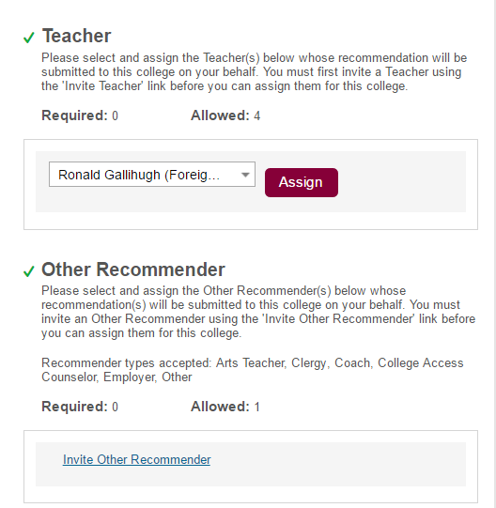
DON’T FORGET!
In addition to adding your
recommenders on the Manage Recommenders screen, you will also need to assign them to each
school on your My Colleges list.
Pro tip: Each school chooses the number of recommendations they wish to receive. Double check those requirements!
^{© 2016 The Common Application}
Notes:
After you enter information for your recommender, you will need to assign that recommender to the schools to which they’ll be providing a letter of recommendation. Once the recommender is assigned, you will see “assigned” next to their name.
You do not need to assign your counselor to every school. We assign your counselor automatically.

Slide 16
STATUS & MANAGEMENT
Always contact the recommendation provider if you are changing their invitation or have questions about their progress.
^{© 2016 The Common Application}

Slide 17
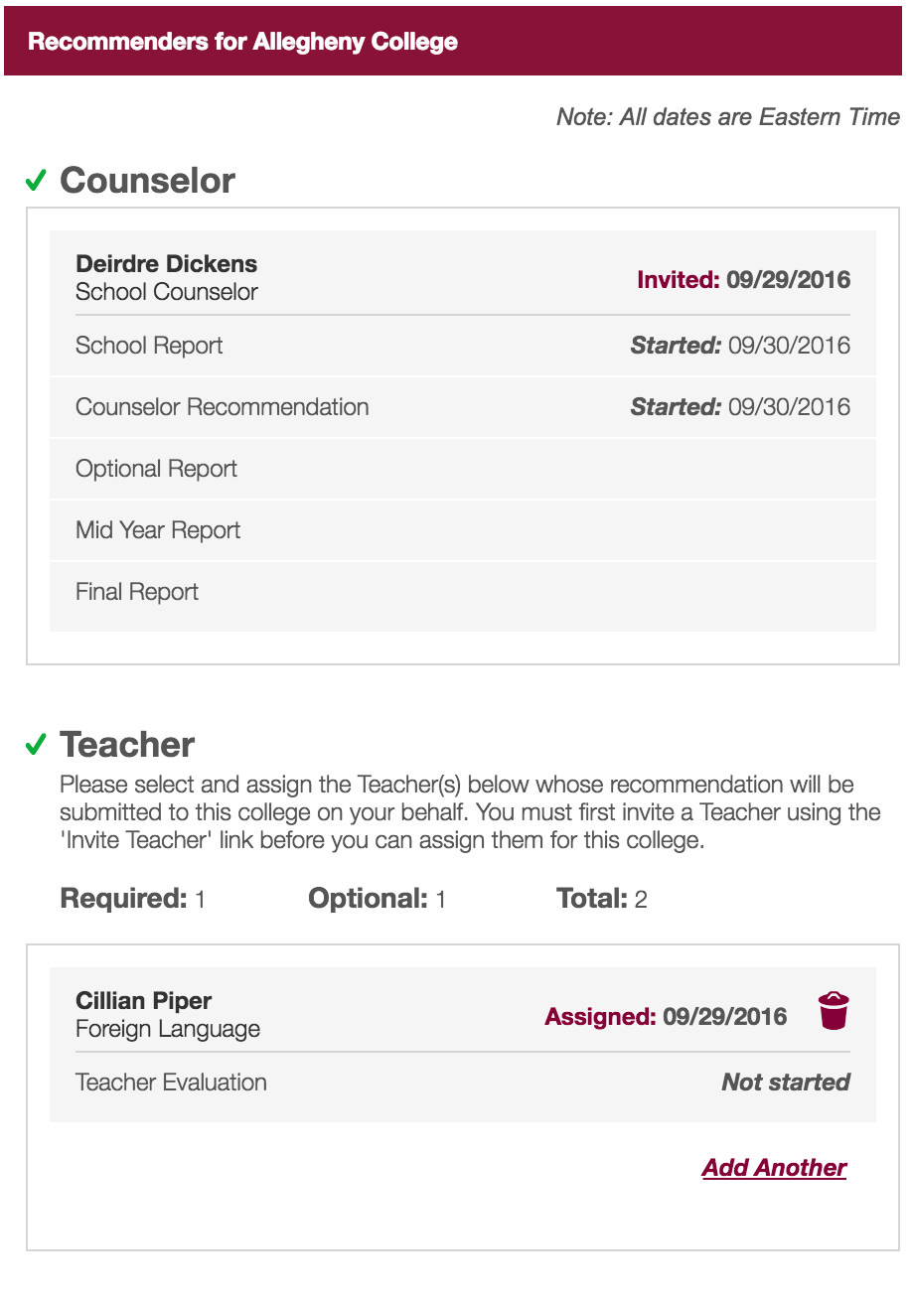
Once you’ve added and assigned Recommenders, you can see some basic information about the status of the forms they are submitting on your behalf.
As your recommenders complete these forms, you will see the status of the forms change here.
^{© 2016 The Common Application}

Slide 18
RECOMMENDATION STATUSES
Not Started - the recommender has not yet begun your recommendation.
Started - your recommender has opened your recommendation file, but has not yet submitted it.
Submitted - your recommender has fully submitted your recommendation, and there is no further action required on their part.
Downloaded - the college's admission office has downloaded a copy of the recommendation from our server.
Pro tip: Be sure to communicate regularly with your recommenders, especially when deadlines approach!
^{© 2016 The Common Application}

Slide 19
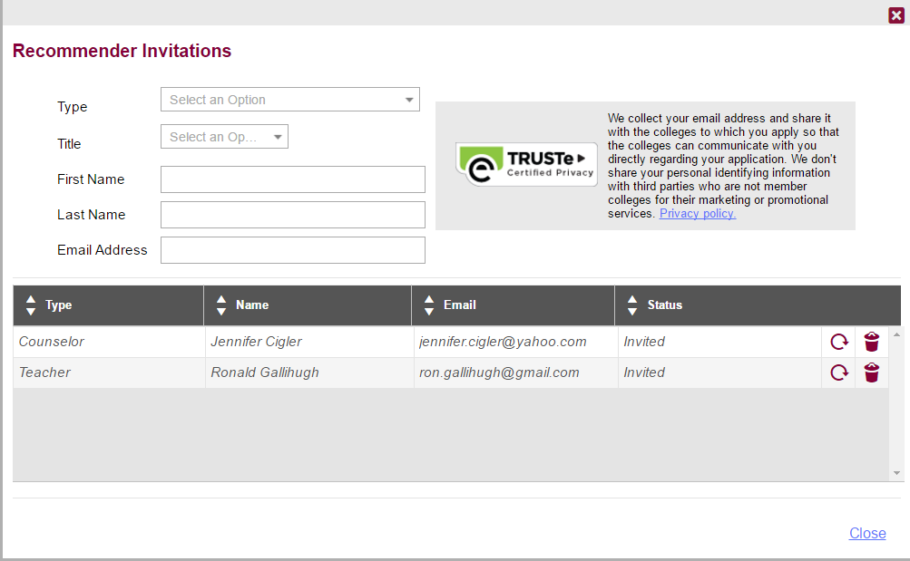
You will be able to remove a recommender only if the form has not already been submitted.
Click on the refresh circle to
resend a recommender invite.
^{© 2016 The Common Application}
Notes:
You can resend a recommender invite from the Manage Recommenders screen by clicking the refresh circle.

Slide 20



LEARN MORE
THE RECOMMENDATION PROCESS
TIPS & BEST PRACTICES
COMMON APP TOUR
This video will guide you through the process of inviting and assigning recommenders.
Best practices to keep in mind as you complete your applications.
Learn how to navigate the Common App.
^{© 2016 The Common Application}

